Slide 1
DMAS: Decentralized Multiagent Simulation – System Architecture
Alan Aguilar Jaramillo, Ben Gorr, Chrissi Erwin, Dr Daniel Selva Valero

Slide 2
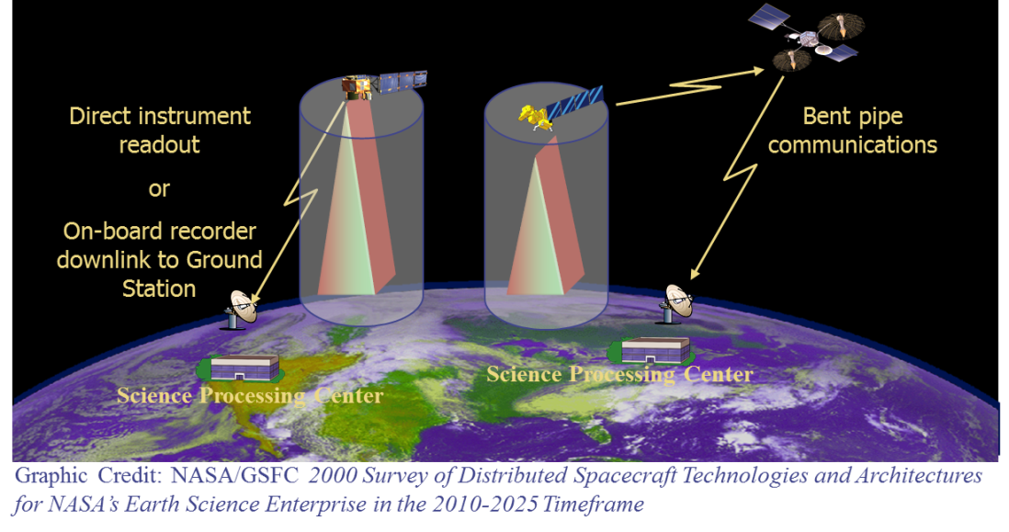
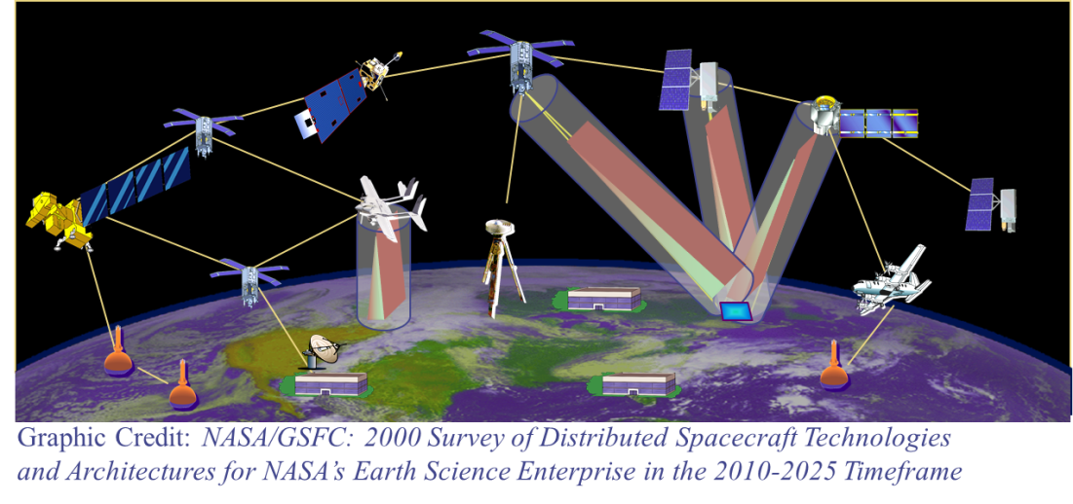
Motivation and Challenges
Space-based Earth observation is undergoing a paradigm change
Easier access to space
More affordable access to space
Higher grade commercial off-the shelf components
Increased computation power
Implementation of Distributed Architectures
Many smaller and heterogeneous satellites, w/ crosslinks
Federations (coordination among assets owned and operated by different organizations)
Onboard measurements processing
Starting to be implemented (e.g., TROPICS [1], CYGNSS [2])
Due to operations logistics, large constellations demand autonomous operations to maximize performance
NASA Sensor Web concept (image credit NASA GSFC)

Slide 3
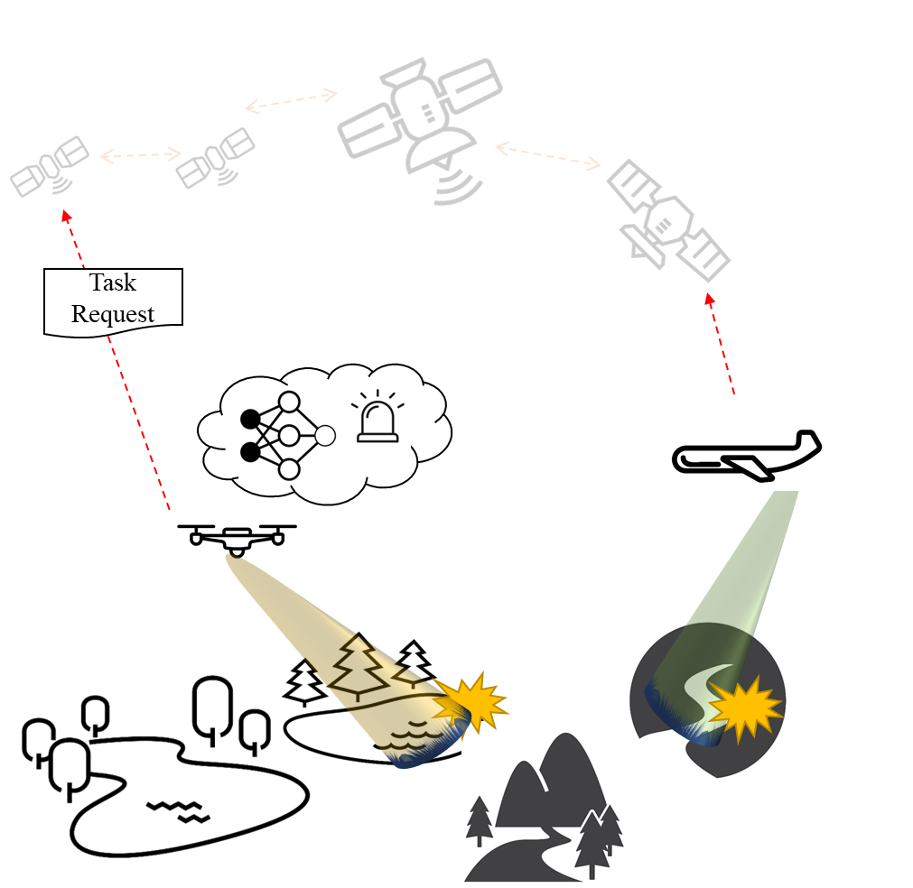
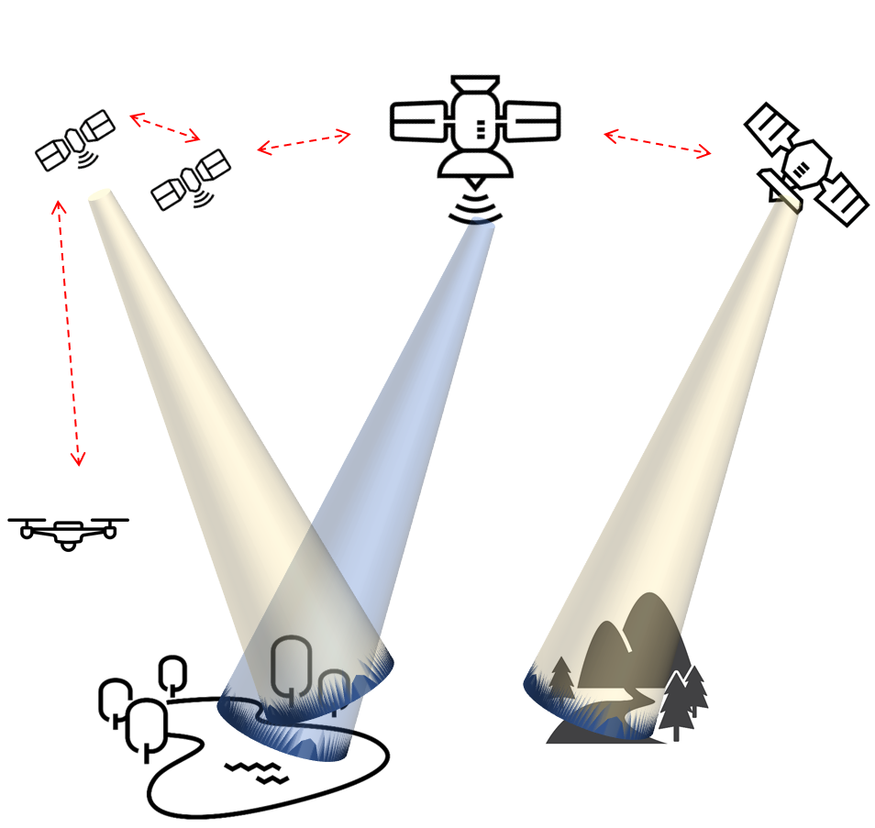
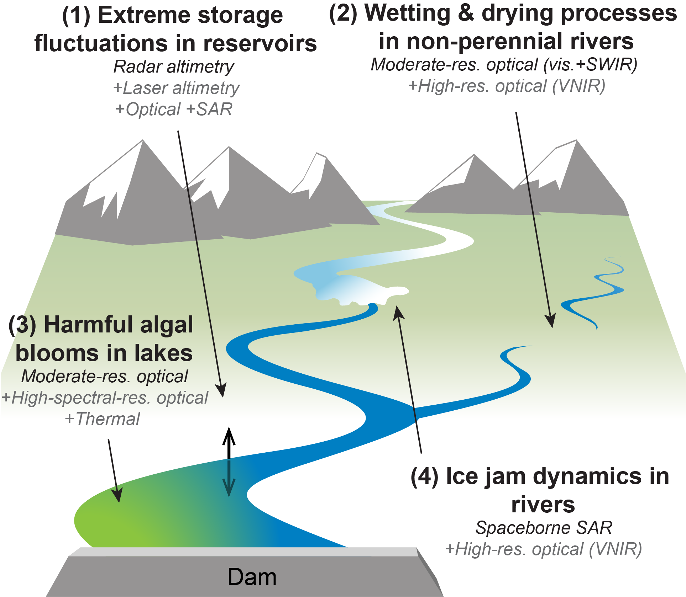
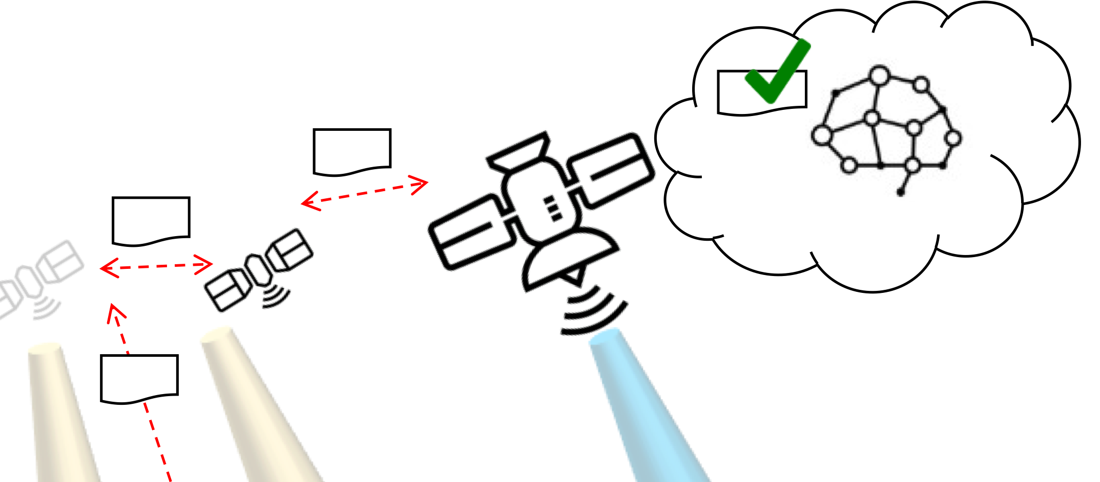
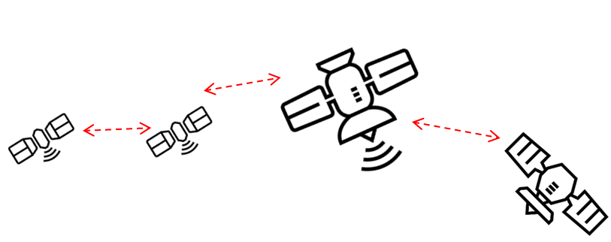
Mission Concept: 3D-CHESS
Goal: provide proof of concept for a context-aware network of heterogeneous sensors, in the context of an inland water ecosystem monitoring mission
1 – Default missions; data processing
2 – Event detected; task request sent
Proposed 3D-CHESS Scenario
3 - Knowledge-based task filtering
4 – Decentralized planning
Proposed 3D-CHESS Concept of Operations
Notes:
To give you an idea of where we are today in terms of actual missions that have flown

Slide 4
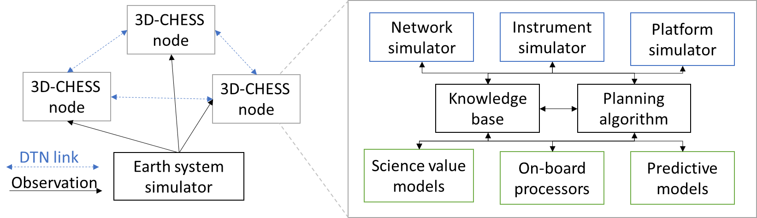
Mission Concept: 3D-CHESS
Goal: provide proof of concept for a context-aware network of heterogeneous sensors, in the context of an inland water ecosystem monitoring mission
Proposed 3D-CHESS Simulation Framework
Proposed 3D-CHESS Scenario
Notes:
To give you an idea of where we are today in terms of actual missions that have flown

Slide 5
Decentralized Multiagent Simulation (DMAS)
Agent 2
Client
Agent to Agent: Task, Requests, Results (broadcasted or targeted)
Agent 1
Client
Agent 3
Client
Agent to Environment: Sense agent state, perform measurement
Environment to all Agents: Broadcasts simulation events
Environment
Server
Proposed 3D-CHESS Simulation Framework
DMAS Simulation Framework

Slide 6
Inter-Agent Messages
Receivers
Broadcast: All nodes in the network
Targeted: Specific node(s) in the network
Action: From one node to itself
Tasks
Actions to be performed by the receiving agent
Is the output of each agent’s scheduling algorithm
Requests
Actions that may be performed by the agent if scheduled
Is the input of the agent’s scheduling algorithm
Data/Information
Contains some kind of information relevant to the receiving agent
i.e., Measurement results, agent state, etc…
Agent 2
Client
Agent to Agent: Task, Requests, Results (broadcasted or targeted)
Agent 1
Client
Agent 3
Client
Agent to Environment: Sense agent state, receives measurement information
Environment to all Agents: Broadcasts simulation events
Environment
Server
DMAS Simulation Framework

Slide 7
Environment Server Architecture
Simulation Control
Initialize network and wait for all agents to synchronize with the server
Generate and publish a ledger of agent port addresses
Broadcast simulation start and end
Broadcast simulation time (optional)
Earth System Simulator
Propagate the state of the world
Create data for instrument to measure
Agent External State Propagator
Agent position, velocity, attitude, and eclipse state
Respond to requests from agents (be sensed by agents)
Broadcast agent-related events
i.e., inform agent that it has entered eclipse, so its solar panels stop producing power regardless of whether the agent sensed the eclipse or not.
Environment
Server
Simulation Control
-Simulation Control Events
-Simulation Clock (optional)
PUB
Agents
Agent External State Propagator
REP
-Agent Events
-GP access req
-GS access req
-Agent access req
-Agent state req
Objective: Make the environment house all “True/Real” values of the simulation and have the agents sense those values through their sensors and instruments.
-Measurement observation metrics req
Earth System Simulator

Slide 8
Agent Simulation Architecture
Agent
Simulation Module
Event Handler
-Simulation Events
Sim Start/End
-Scenario Events
-Simulation Events
SUB
-Scenario Events
Environment
-Measurement Results (from self or other agents)
-Information Request
REQ
Science Module
-GP access info
-GS access info
-Agent access info
-Agent state info
-Measurement observation metrics info
-Measurement Data (out)
-Measurement Requests
-Information Requests
-Measurement Request (in)
-Information Request (in)
-Measurement Results (in)
-Planner Results (in)
Engineering Module
-Agent State
-Planner Results (in)
-Measurement Requests (in)
Proposed 3D-CHESS Agent Framework
REQ
Scheduler Module
-Scheduled Measurement Measurements
-Measurement Requests (out)
-Planner Results (out)
Other Agents
REP
-Measurement Request (out)
-Information Request (out)
-Measurement Results (out)
-Planner Results (out)
DMAS Agent Framework

Slide 9
Agent Simulation Architecture
Agent
Simulation Module
Event Handler
-Simulation Events
Sim Start/End
-Scenario Events
-Simulation Events
SUB
-Scenario Events
Environment
-Measurement Results (from self or other agents)
-Information Request
REQ
Science Module
-GP access info
-GS access info
-Agent access info
-Agent state info
-Measurement observation metrics info
-Measurement Data (out)
-Measurement Requests
-Information Requests
-Measurement Request (in)
-Information Request (in)
-Measurement Results (in)
-Planner Results (in)
Engineering Module
-Agent State
-Planner Results (in)
-Measurement Requests (in)
Proposed 3D-CHESS Agent Framework
REQ
Scheduler Module
-Scheduled Measurement Measurements
-Measurement Requests (out)
-Planner Results (out)
Other Agents
REP
-Measurement Request (out)
-Information Request (out)
-Measurement Results (out)
-Planner Results (out)
DMAS Agent Framework

Slide 10
Agent Simulation Architecture
Objective: Simulate the agent’s internal state and provide realistic behavior and capabilities based on its components and operations
Agent
Simulation Module
Event Handler
-Simulation Events
Sim Start/End
Desired Capabilities:
Agent State Tracking
Sense and track agent’s external state (position, velocity, attitude, and eclipse)
Track agent’s internal state (power and data generation, storage, and consumption, component status, etc.)
React to environment events
i.e., turn off solar panels if eclipse event occurs
Scheduler Action Performance and Rejection
Receive and perform instructions from scheduler
Revert actions or even turn off agent if a critical state is reached
i.e., interrupt a measurement if power consumption from instruments exceeds generation
Instrument Simulation
Sense the environment
Provide realistic measurement results to science module
Network Simulator
Send and receive messages from/to other agents
Capture network delays
Due to transmission latency and data-rate
Due to buffer saturation
-Scenario Events
-Simulation Events
SUB
-Scenario Events
Environment
-Measurement Results (from self or other agents)
-Information Request
REQ
Science Module
-GP access info
-GS access info
-Agent access info
-Agent state info
-Measurement observation metrics info
-Measurement Requests
-Information Requests
-Measurement Request (in)
-Information Request (in)
-Measurement Results (in)
-Planner Results (in)
Engineering Module
-Agent State
-Planner Results (in)
-Measurement Requests (in)
REQ
Scheduler Module
-Scheduled Measurement Measurements
-Measurement Requests (out)
-Planner Results (out)
Other Agents
REP
-Measurement Request (out)
-Information Request (out)
-Measurement Results (out)
-Planner Results (out)
DMAS Agent Framework

Slide 11
Engineering Module
Agent
Barebones Engineering Module:
Platform Emulator
Simulates the agent’s on-board subsystems
Command and Data Handling (CDH)
Receive commands to perform from planner
Track and manage agent’s internal memory state
React to the platform’s critical or failure states
Guidance Navigation and Control (GNC)
Sense and track agent’s position and velocity vector
Sense and track agent’s eclipse state
Electrical Power Subsystem (EPS)
Track power generation/consumption
Comms
Emulate transceiver buffers
Discards messages that cannot fit in buffers
Payload
Requests measurement information to the environment
Provides CDH with simulated instrument results from an observation
Network Emulator
Simulate latency due to range latency or channel data-rate
Simulation Maintenance Module
Event Handler
-Simulation Events
Sim Start/End
-Scenario Events
-Simulation Events
SUB
Environment
Engineering Module
REQ
Platform Emulator
-Measurement Results (from self or other agents)
-Information Request
-State
-Data (out)
CDH
Science Module
-Agent State
Memory Emulator
-Agent access event
Reactive Planner
-Measurement Data (out)
-Measurement Request (out)
-Information Request (out)
-Measurement Results (out)
-Planner Results (out)
-Emergency Task(s)
-Task(s)
-Measurement Requests (from self or towards out)
-Information Requests (out)
-Data Transmission Requests
Operations Executor
-Tasks (for self or out)
-Measurement Requests (out)
-Information Requests (out)
-Measurement Results (out)
-Planner Results (out)
--Itemized task instructions
REP
-Pos/Vel info
GNC
Planning Module
-Subsystem State(s)
-Task completion status
-Agent State
-Planner Results (in)
-Measurement Requests (in)
Other Agents
Network Emulator
-Eclipse info
-Eclipse event
EPS
REQ
-Agent access info
Comms
-Received Data
-Measurement Request (in)
-Information Request (in)
-Measurement Results (in)
-Planner Results (in)
-Msgs
Payload
-GP Measurement
-Perceived Data

Slide 12




Engineering Module - Plan Execution
Scenario:
2 Agents, one with instrument A and another with instrument B
1 GP of interest
Timeline:
Agent 1 performs routine measurement of GP1 with instrument A at T = 1
Agent 1 processes measurement and concludes GP1 is an area of interest for a measurement with instrument B
Agent 1 creates a measurement request for all agents in the network including itself
Agent 1 concludes that it does NOT possess the capabilities to perform the measurement request and therefore does not act on the request
Agent 1 attempts to send measurement request to Agent 2 at T = 2 but is unsuccessful (out of LOS)
Agent 1 sends measurement request to Agent 2 at T = 3
Agent 2 receives measurement request from Agent 1
Agent 2 concludes that it CAN perform the measurement in the request
Agent 2 schedules a measurement with instrument B at its next access to GP1 at T = 4
Agent 2 performs measurement
Agent 2 sends measurement results to Agent 1 at T = 4
Instr A
Instr B
1
2
GP1

Slide 13
Engineering Module - Plan Execution
Simulation Maintenance Module
Event Handler
-Simulation Events
Sim Start/End
SUB
Environment
Engineering Module
REQ
Platform Emulator
CDH
Science Module
Scenario step:
Agent 1 performs routine measurement of GP1 with instrument A
Memory Emulator
Reactive Planner
Operations Executor
REP
GNC
Planning Module
-Agent State
-Current time
Other Agents
Network Emulator
EPS
REQ
Comms
Payload

Slide 14


Engineering Module - Plan Execution
1
Simulation Maintenance Module
Event Handler
-Simulation Events
Sim Start/End
SUB
Environment
Engineering Module
REQ
Platform Emulator
”Itemized plan:
-Wait for T=1
-Turn on instrument A
-Perform measurement
-Send data to science module”
CDH
Science Module
Scenario step:
Agent 1 performs routine measurement of GP1 with instrument A
Memory Emulator
Reactive Planner
“Planning complete, perform routine plan!”
Operations Executor
-Task: “Measure GP1 with Instrument A at T=1”
REP
GNC
Planning Module
Other Agents
Network Emulator
EPS
REQ
Comms
Payload

Slide 15

Engineering Module - Plan Execution
1
Simulation Maintenance Module
Event Handler
-Simulation Events
Sim Start/End
SUB
Environment
Engineering Module
REQ
Platform Emulator
CDH
Science Module
Scenario step:
Agent 1 performs routine measurement of GP1 with instrument A
Memory Emulator
Reactive Planner
“T is now T=1!”
-”Turn on Instrument A”
Operations Executor
REP
GNC
Planning Module
Other Agents
Network Emulator
EPS
REQ
Comms
“Turning on instrument A…"
Payload

Slide 16

Engineering Module - Plan Execution
1
Simulation Maintenance Module
Event Handler
-Simulation Events
Sim Start/End
“Accessing data for GP1 at T=1…
Data found! Sending to Agent 1…”
SUB
Environment
Engineering Module
REQ
-GP Data
Platform Emulator
CDH
Science Module
Scenario step:
Agent 1 performs routine measurement of GP1 with instrument A
Memory Emulator
Reactive Planner
Operations Executor
REP
GNC
Planning Module
Other Agents
Network Emulator
EPS
REQ
Comms
“Performing measurement. Requesting info from environment…”
Payload
-GP Data

Slide 17
Engineering Module - Plan Execution
1
Simulation Maintenance Module
Event Handler
-Simulation Events
Sim Start/End
SUB
Environment
Engineering Module
REQ
“Measurement data is now stored in internal memory!”
Platform Emulator
CDH
Science Module
Scenario step:
Agent 1 performs routine measurement of GP1 with instrument A
Memory Emulator
Reactive Planner
Operations Executor
REP
GNC
Planning Module
Other Agents
Network Emulator
EPS
REQ
Comms
“Measurement performed! Saving results…”
Payload
-Instrument Data

Slide 18
Engineering Module - Plan Execution
1
Simulation Maintenance Module
Event Handler
-Simulation Events
Sim Start/End
SUB
Environment
“Processing results…
GP1 should be measured with Instrument B!”
Engineering Module
REQ
“Sending results for processing…”
Platform Emulator
CDH
-Instrument Data
Science Module
Scenario step:
Agent 1 processes measurement and concludes GP1 is an area of interest for a measurement with instrument B
Memory Emulator
Reactive Planner
Operations Executor
REP
GNC
Planning Module
Other Agents
Network Emulator
EPS
REQ
Comms
Payload

Slide 19
Engineering Module - Plan Execution
1
Simulation Maintenance Module
Event Handler
-Simulation Events
Sim Start/End
SUB
Environment
Engineering Module
REQ
Platform Emulator
CDH
Science Module
Scenario step:
Agent 1 creates a measurement request for all agents in the network including itself
Memory Emulator
Reactive Planner
-Measurement Requests (to self): “Measure GP1 with Instrument B”
-Measurement Requests (to all): “Measure GP1 with Instrument B”
Operations Executor
REP
GNC
Planning Module
Other Agents
Network Emulator
EPS
REQ
Comms
Payload

Slide 20
Engineering Module - Plan Execution
1
Simulation Maintenance Module
Event Handler
-Simulation Events
Sim Start/End
SUB
Environment
Engineering Module
REQ
Platform Emulator
CDH
Science Module
Scenario step:
Agent 1 concludes that it does NOT possess the capabilities to perform the measurement request and therefore does not act on the request
Memory Emulator
Reactive Planner
-Measurement Requests (to self): “Measure GP1 with Instrument B”
Operations Executor
REP
GNC
Planning Module
Other Agents
Network Emulator
EPS
“I do not have instrument B therefore I cannot perform this request.”
REQ
Comms
Payload

Slide 21
Engineering Module - Plan Execution
1
Simulation Maintenance Module
Event Handler
-Simulation Events
Sim Start/End
SUB
Environment
Engineering Module
REQ
Platform Emulator
CDH
Science Module
Scenario step:
Agent 1 sends measurement request to Agent 2
Memory Emulator
Reactive Planner
Operations Executor
-Measurement Requests (to all): “Measure GP1 with Instrument B”
REP
GNC
Planning Module
Other Agents
Network Emulator
EPS
REQ
“Scheduling measurement request broadcast for next access with Agent 2 at T=2”
Comms
Payload

Slide 22
Engineering Module - Plan Execution
1
Simulation Maintenance Module
Event Handler
-Simulation Events
Sim Start/End
SUB
Environment
Engineering Module
REQ
”Itemized plan:
-Place message in comms buffer
-Wait for T=2
-Wait for access to Agent 2
-Transmit message
-Delete message from buffer”
Platform Emulator
CDH
Science Module
Scenario step:
Agent 1 sends measurement request to Agent 2
Memory Emulator
Reactive Planner
Operations Executor
-Task: “Send Measurement req to Agent 2 at T=2”
“Planning complete, perform plan!”
REP
GNC
Planning Module
Other Agents
Network Emulator
EPS
REQ
Comms
Payload

Slide 23
Engineering Module - Plan Execution
1
Simulation Maintenance Module
Event Handler
-Simulation Events
Sim Start/End
SUB
Environment
Engineering Module
REQ
Platform Emulator
CDH
Science Module
Scenario step:
Agent 1 sends measurement request to Agent 2
Memory Emulator
Reactive Planner
-Measurement Request Message
Operations Executor
REP
GNC
Planning Module
“Outgoing message placed in buffer. Updating current buffer state…”
Other Agents
Network Emulator
EPS
REQ
Comms
Payload

Slide 24
Engineering Module - Plan Execution
1
Simulation Maintenance Module
Event Handler
-Simulation Events
Sim Start/End
SUB
Environment
Engineering Module
REQ
Platform Emulator
CDH
Science Module
Scenario step:
Agent 1 sends measurement request to Agent 2
Memory Emulator
Reactive Planner
“T is now T=2!”
-“Wait for access to agent 2”
Operations Executor
REP
GNC
Planning Module
“Waiting for access to agent 2…
Polling environment until access is confirmed…”
Other Agents
Network Emulator
EPS
REQ
Comms
Payload

Slide 25
Engineering Module - Plan Execution
1
Simulation Maintenance Module
Event Handler
-Simulation Events
Sim Start/End
“Accessing agent data for Agents 1 and 2 at T=2…
Data found! Sending to Agent 1…”
SUB
Environment
Engineering Module
REQ
-Agent Access Info
Platform Emulator
CDH
Science Module
Scenario step:
Agent 1 sends measurement request to Agent 2
Memory Emulator
Reactive Planner
Operations Executor
REP
GNC
Planning Module
Other Agents
Network Emulator
EPS
“Agent 2 is NOT accessible. Trying again at T = 3…”
REQ
-Agent Access Info
Comms
Payload

Slide 26
Engineering Module - Plan Execution
1
Simulation Maintenance Module
Event Handler
-Simulation Events
Sim Start/End
“Accessing agent data for Agents 1 and 2 at T=3…
Data found! Sending to Agent 1…”
SUB
Environment
Engineering Module
REQ
-Agent Access Info
Platform Emulator
CDH
Science Module
Scenario step:
Agent 1 sends measurement request to Agent 2
Memory Emulator
Reactive Planner
“T is now T=3!”
Operations Executor
REP
GNC
Planning Module
Other Agents
Network Emulator
EPS
“Agent 2 is now accessible!”
REQ
-Agent Access Info
Comms
Payload

Slide 27
Engineering Module - Plan Execution
1
Simulation Maintenance Module
Event Handler
-Simulation Events
Sim Start/End
SUB
Environment
Engineering Module
REQ
Platform Emulator
CDH
Science Module
Scenario step:
Agent 1 sends measurement request to Agent 2
Memory Emulator
“T is now T=3 and Agent 2 is accessible!”
Reactive Planner
-“Send measurement request to agent 2”
Operations Executor
-Measurement Request
REP
Planning Module
GNC
Other Agents
Network Emulator
EPS
“Sending message…”
REQ
Comms
-Measurement Request
Payload

Slide 28

Engineering Module - Plan Execution
2
Simulation Maintenance Module
Event Handler
-Simulation Events
Sim Start/End
SUB
Environment
Engineering Module
REQ
Platform Emulator
CDH
“Received a measurement request. Forwarding to Planning Module…”
Science Module
Scenario step:
Agent 2 receives measurement request from Agent 1
Memory Emulator
Reactive Planner
Operations Executor
REP
GNC
Planning Module
Other Agents
Network Emulator
EPS
“Received a message from Agent 1!”
-Measurement Request
REQ
Comms
-Measurement Request
-Received Data
Payload

Slide 29


Engineering Module - Plan Execution
2
Simulation Maintenance Module
Event Handler
-Simulation Events
Sim Start/End
SUB
Environment
Engineering Module
REQ
Platform Emulator
CDH
Science Module
Scenario step:
Agent 2 concludes that it CAN perform the measurement in the request
Memory Emulator
Reactive Planner
Operations Executor
REP
GNC
Planning Module
-Agent State
-Measurement Requests: “Measure GP1 with Instrument B”
Other Agents
Network Emulator
EPS
“I have instrument B, therefore I CAN perform this measurement request”
REQ
Comms
Payload

Slide 30
Engineering Module - Plan Execution
2
Simulation Maintenance Module
Event Handler
-Simulation Events
Sim Start/End
SUB
Environment
Engineering Module
REQ
Platform Emulator
CDH
Science Module
Scenario step:
Agent 2 schedules a measurement with instrument B at its next access to GP1 at T=4
Memory Emulator
Reactive Planner
Operations Executor
REP
GNC
Planning Module
Other Agents
Network Emulator
EPS
“Scheduling measurement of GP1 with Instrument B at T=4”
REQ
Comms
Payload

Slide 31

Engineering Module - Plan Execution
2
Simulation Maintenance Module
Event Handler
-Simulation Events
Sim Start/End
SUB
Environment
Engineering Module
REQ
”Itemized plan:
-Wait for T=4
-Turn on instrument B
-Perform measurement
-Send data to science module
-Send data to Agent 1
Platform Emulator
CDH
Science Module
Scenario step:
Agent 2 performs measurement
Memory Emulator
Reactive Planner
Operations Executor
-Task: “Measure GP1 with Instrument B at T=B”
“Planning complete, perform plan!”
REP
GNC
Planning Module
Other Agents
Network Emulator
EPS
REQ
Comms
Payload

Slide 32

Engineering Module - Plan Execution
2
Simulation Maintenance Module
Event Handler
-Simulation Events
Sim Start/End
SUB
Environment
Engineering Module
REQ
Platform Emulator
CDH
Science Module
Scenario step:
Agent 2 performs measurement
Memory Emulator
Reactive Planner
“T is now T=4!”
-”Turn on Instrument B”
Operations Executor
REP
GNC
Planning Module
Other Agents
Network Emulator
EPS
REQ
Comms
“Turning on instrument B…"
Payload

Slide 33

Engineering Module - Plan Execution
2
Simulation Maintenance Module
Event Handler
-Simulation Events
Sim Start/End
“Accessing data for GP1 at T=4…
Data found! Sending to Agent 2…”
SUB
Environment
Engineering Module
REQ
-GP Data
Platform Emulator
CDH
Science Module
Scenario step:
Agent 2 performs measurement
Memory Emulator
Reactive Planner
Operations Executor
REP
GNC
Planning Module
Other Agents
Network Emulator
EPS
REQ
Comms
“Performing measurement. Requesting info from environment…”
Payload
-GP Data

Slide 34
Engineering Module - Plan Execution
2
Simulation Maintenance Module
Event Handler
-Simulation Events
Sim Start/End
SUB
Environment
Engineering Module
REQ
“Measurement data is now stored in internal memory!”
Platform Emulator
CDH
Science Module
Scenario step:
Agent 2 performs measurement
Memory Emulator
Reactive Planner
Operations Executor
REP
GNC
Planning Module
Other Agents
Network Emulator
EPS
REQ
Comms
“Measurement performed! Saving results…”
Payload
-Instrument Data

Slide 35

Engineering Module - Plan Execution
2
Simulation Maintenance Module
Event Handler
-Simulation Events
Sim Start/End
SUB
Environment
Engineering Module
“Processing results…
Higher level products obtained. No new event detected.”
REQ
“Sending results for processing…”
Platform Emulator
CDH
-Instrument Data
Science Module
Scenario step:
Agent 2 performs measurement
Memory Emulator
Reactive Planner
Operations Executor
REP
GNC
Planning Module
Other Agents
Network Emulator
EPS
REQ
Comms
Payload

Slide 36
Engineering Module - Plan Execution
2
Simulation Maintenance Module
Event Handler
-Simulation Events
Sim Start/End
SUB
Environment
Engineering Module
REQ
Platform Emulator
CDH
-Instrument Data
Science Module
Scenario step:
Agent 2 sends measurement results to Agent 1 at T = 4
“Sending results to Agent 1”
Memory Emulator
Reactive Planner
-”Send measurement results to Agent 1”
-Measurement results
Operations Executor
-Measurement Results
REP
Planning Module
GNC
Other Agents
Network Emulator
EPS
“Sending data to Agent 1…”
REQ
Comms
-Measurement Results
Payload

Slide 37

Engineering Module - Plan Execution
Plan Execution Sequence:
Plan Execution Sequence:
Plan Execution Sequence:
Plan Execution Sequence:
Scheduler Module
Task: “Perform measurement of GP 123 @ t=5 w/ instr1”
Scheduler Module
1- Wait for t = 5
2- Maneuver to observe GP 123 with instr1
3- Turn on instr1
4- Sense GP 123
5- Turn off intr1
Scheduler Module
Scheduler Module
“Waiting for t=5…
Wait complete!
State is nominal, proceed to next instruction”
Operations Executor
Operations Executor
Operations Executor
Operations Executor
“Performing maneuver…
Power insufficient to perform maneuver. Cancelling action and reassessing plan…”
“cancel plan”
Platform Emulator
Platform Emulator
Platform Emulator
Platform Emulator
Receive measurement plan from scheduler
Generate operations plan from measurement plan
Execute Plan
React to Plan Execution Errors

Slide 38
Agent Simulation Architecture
Agent
Simulation Module
Event Handler
-Simulation Events
Sim Start/End
-Scenario Events
-Simulation Events
SUB
-Scenario Events
Environment
-Measurement Results (from self or other agents)
-Information Request
REQ
Science Module
-GP access info
-GS access info
-Agent access info
-Agent state info
-Measurement observation metrics info
-Measurement Data (out)
-Measurement Requests
-Information Requests
-Measurement Request (in)
-Information Request (in)
-Measurement Results (in)
-Planner Results (in)
Engineering Module
-Agent State
-Planner Results (in)
-Measurement Requests (in)
Proposed 3D-CHESS Agent Framework
REQ
Scheduler Module
-Scheduled Measurement Measurements
-Measurement Requests (out)
-Planner Results (out)
Other Agents
REP
-Measurement Request (out)
-Information Request (out)
-Measurement Results (out)
-Planner Results (out)
DMAS Agent Framework

Slide 39
Agent Simulation Architecture
Objective: Simulate the agent’s internal state and provide realistic behavior and capabilities based on its components and operations
Agent
Simulation Module
Event Handler
-Simulation Events
Sim Start/End
Desired Capabilities:
On-board Data Processing
Process raw data being sensed by the agent’s instrument
Process raw data sent from other agents who may lack processing capabilities
Create measurement requests for areas of interest
Create a data-base with measurements from parent agent or from other agents
Use data-base to detect areas of interest based on processed data
Use predictive models to infer possible future events in areas of interest
Request missing data as a measurement request or an information request to parent agent or to other agents if results would complete predictive model and if prediction would be worth the effort
Quantify Scientific Value of a Measurement
Use predictive models, data-base, and (or) mission requirements to infer the scientific benefit of a potential measurement being considered by the scheduler
-Scenario Events
-Simulation Events
SUB
-Scenario Events
Environment
-Measurement Results (from self or other agents)
-Information Request
REQ
Science Module
-GP access info
-GS access info
-Agent access info
-Agent state info
-Measurement observation metrics info
-Measurement Data (out)
-Measurement Requests
-Information Requests
-Measurement Request (in)
-Information Request (in)
-Measurement Results (in)
-Planner Results (in)
Engineering Module
-Agent State
-Planner Results (in)
-Measurement Requests (in)
REQ
Scheduler Module
-Scheduled Measurement Measurements
-Measurement Requests (out)
-Planner Results (out)
Other Agents
REP
-Measurement Request (out)
-Information Request (out)
-Measurement Results (out)
-Planner Results (out)
DMAS Agent Framework

Slide 40
Science Module
Agent
Simulation Module
Science Module
Event Handler
-Simulation Events
Sim Start/End
On-board Processor
-Processed data
Science “reasoning”
-Environment Events
-Simulation Events
SUB
-Model req/results
-Environment Events
Environment
Science data-base
-Past data
Science Predictive Models
-Measurement Data (from self or in)
-Information Request
REQ
-Proposed Measurement Requests
-Proposed Information
Requests
-Mission Requirements
-Past measurement data
-Model req/results
-GP access req
-GS access req
-Agent access req
-Agent state req
-Measurement observation metrics req
Science Value Model
-Measurement Requests
-Information Request
-Measurement Request
-Information Request
-Measurement Results
-Planner Results
Engineering Module
REQ
Other Agents
-Agent State
-Planner Results (in)
-Measurement Requests (in)
REP
Scheduler Module
-Measurement Request
-Information Request
-Measurement Results
-Planner Results
-Tasks (for self or out)
-Measurement Requests (out)
-Information Requests (out)
-Measurement Results (out)
-Planner Results (out)

Slide 41
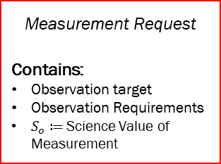
Science Module
Agent
Simulation Module
Science Module
Event Handler
-Simulation Events
Sim Start/End
On-board Processor
-Processed data
Science “reasoning”
-Environment Events
-Simulation Events
SUB
-Model req/results
-Environment Events
Environment
Science data-base
-Past data
Science Predictive Models
-Measurement Data (from self or in)
-Information Request
REQ
-Proposed Measurement Requests
-Proposed Information
Requests
-Mission Requirements
-Past measurement data
-Model req/results
-GP access req
-GS access req
-Agent access req
-Agent state req
-Measurement observation metrics req
Science Value Model
-Measurement Requests
-Information Request
Measurement Request
Contains:
Observation target
Observation Requirements
$S_{o}≔$ Science Value of Measurement
-Measurement Request
-Information Request
-Measurement Results
-Planner Results
Engineering Module
REQ
Other Agents
-Agent State
-Planner Results (in)
-Measurement Requests (in)
REP
Scheduler Module
-Measurement Request
-Information Request
-Measurement Results
-Planner Results
-Tasks (for self or out)
-Measurement Requests (out)
-Information Requests (out)
-Measurement Results (out)
-Planner Results (out)

Slide 42
Science Module – Chl example
Agent
Simulation Module
Science Module
Event Handler
-Simulation Events
Sim Start/End
On-board Processor – 2BDA algorithm
-Chl-a product
Science “reasoning” – sees if chlorophyll concentration is above 1 standard deviation
-Environment Events
-Simulation Events
SUB
-Environment Events
Environment
Science data-base – past and current chlorophyll levels
-Past chl-a levels
Science Predictive Models – rainfall? Temperature? Historical?
-Raw multi/hyperspectral images (from self or other agents)
REQ
-Chl-a outliers
-Observation metrics
-Algal bloom likelihood
-GP access req
-GS access req
-Agent access req
-Agent state req
-Measurement observation metrics req
-Mission Requirements
-Past measurement data
-Measurement Requests
-Information Request
-Measurement Data (from self)
Science Value Model
-Measurement Requests
-Information Request
-Measurement Request
-Information Request
-Measurement Results
-Planner Results
Engineering Module
REQ
Other Agents
-Agent State
-Planner Results (in)
-Measurement Requests (in)
REP
Scheduler Module
-Measurement Request
-Information Request
-Measurement Results
-Planner Results
-Scheduled Measurement Measurements
-Measurement Requests (out)
-Planner Results (out)

Slide 43
Agent Simulation Architecture
Agent
Simulation Module
Event Handler
-Simulation Events
Sim Start/End
-Scenario Events
-Simulation Events
SUB
-Scenario Events
Environment
-Measurement Results (from self or other agents)
-Information Request
REQ
Science Module
-GP access info
-GS access info
-Agent access info
-Agent state info
-Measurement observation metrics info
-Measurement Data (out)
-Measurement Requests
-Information Requests
-Measurement Request (in)
-Information Request (in)
-Measurement Results (in)
-Planner Results (in)
Engineering Module
-Agent State
-Planner Results (in)
-Measurement Requests (in)
Proposed 3D-CHESS Agent Framework
REQ
Scheduler Module
-Scheduled Measurement Measurements
-Measurement Requests (out)
-Planner Results (out)
Other Agents
REP
-Measurement Request (out)
-Information Request (out)
-Measurement Results (out)
-Planner Results (out)
DMAS Agent Framework

Slide 44
Agent Simulation Architecture
Objective: Schedule measurement requests according to the agent’s measurement capabilities and state
Agent
Simulation Module
Event Handler
-Simulation Events
Sim Start/End
Desired Capabilities:
Consider Agent capabilities
Use Knowledge-Base to inform whether the agent can perform a measurement
Consider agent’s current and future state
Use engineering module for current state
Predict agent state as proposed scheduled actions are being performed
Schedule measurements as to maximize scientific value and minimize cost
Quantify the predicted scientific value of a measurement and schedule accordingly
Contain some sort of cost model that weighs down the value of measurements. Can be tied to the engineering cost of performing measurements
Publish and receive results to and from other agent if scheduling algorithm require collaboration with other agents
-Scenario Events
-Simulation Events
SUB
-Scenario Events
Environment
-Measurement Results (from self or other agents)
-Information Request
REQ
Science Module
-GP access info
-GS access info
-Agent access info
-Agent state info
-Measurement observation metrics info
-Measurement Data (out)
-Measurement Requests
-Information Requests
-Measurement Request (in)
-Information Request (in)
-Measurement Results (in)
-Planner Results (in)
Engineering Module
-Agent State
-Planner Results (in)
-Measurement Requests (in)
REQ
Scheduler Module
-Scheduled Measurement Measurements
-Measurement Requests (out)
-Planner Results (out)
Other Agents
REP
-Measurement Request (out)
-Information Request (out)
-Measurement Results (out)
-Planner Results (out)
DMAS Agent Framework

Slide 45
Scheduler Module
Agent
Simulation Module
Event Handler
-Simulation Events
Sim Start/End
Science Module
-Environment Events
-Simulation Events
SUB
-Environment Events
Environment
REQ
-Measurement Data (from self or in)
-Information Request (in)
-Measurement Data (out)
-GP access req
-GS access req
-Agent access req
-Agent state req
-Measurement observation metrics req
-Measurement Requests (from self)
Scheduler/Planning Module
-Measurement Requests (in)
Knowledge-Base Instrument Capability Reasoning
-Proposed measurements
-Measurement Requests (out)
-Information Requests (out)
-Data Transmission Request (from self)
-Measurement Request
-Information Request
-Measurement Results
-Planner Results
Engineering Module
-Agent State
-Planner Results (in)
-Proposed plan
-Agent state
Observation Planning (Decentralized multiagent-level)
Operations Planning (agent-level)
REQ
-Tasks (for self or out)
-Measurement Requests (out)
-Information Requests (out)
-Measurement Results (out)
-Planner Results (out)
-Modified plan
-Meas. Perf. Score
Other Agents
-Plan
-Agent state
Meas. Perf. Model
-Predicted observation metrics
REP
Predictive Models
-Measurement Request
-Information Request
-Measurement Results
-Planner Results
-Cost Estimate
Cost Model
-Predicted Agent States

Slide 46
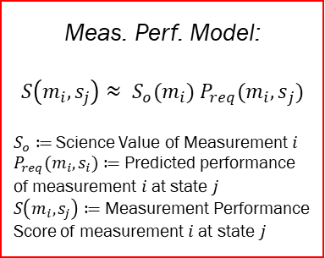
Scheduler Module
Agent
Simulation Module
Event Handler
-Simulation Events
Sim Start/End
Science Module
-Environment Events
-Simulation Events
SUB
-Environment Events
Environment
REQ
-Measurement Data (from self or in)
-Information Request (in)
-Measurement Data (out)
-GP access req
-GS access req
-Agent access req
-Agent state req
-Measurement observation metrics req
-Measurement Requests (from self)
Scheduler/Planning Module
-Measurement Requests (in)
Knowledge-Base Instrument Capability Reasoning
-Proposed measurements
-Measurement Requests (out)
-Information Requests (out)
-Data Transmission Request (from self)
-Measurement Request
-Information Request
-Measurement Results
-Planner Results
Engineering Module
-Agent State
-Planner Results (in)
-Proposed plan
-Agent state
Observation Planning (Decentralized multiagent-level)
Operations Planning (agent-level)
REQ
-Tasks (for self or out)
-Measurement Requests (out)
-Information Requests (out)
-Measurement Results (out)
-Planner Results (out)
-Modified plan
-Meas. Perf. Score
Other Agents
-Plan
-Agent state
Meas. Perf. Model:
$$S\left(m_{i}, s_{j}\right)≈ S_{o}(m_{i}) P_{req}({m_{i}, s}_{j})$$
$S_{o}≔$ Science Value of Measurement $i$
$P_{req}({m_{i}, s}_{i})≔$ Predicted performance of measurement $i$ at state $j$
$S\left(m_{i}, s_{j}\right)≔$ Measurement Performance Score of measurement $i$ at state $j$
Meas. Perf. Model
-Predicted observation metrics
REP
Predictive Models
-Measurement Request
-Information Request
-Measurement Results
-Planner Results
-Cost Estimate
Cost Model
-Predicted Agent States

Slide 47
Agent Simulation Architecture
Module
Properties
Queue inbox
Module* parentModule
Array<Module*> submodules
Agent 2
Client
Methods
void internal_message_router()
void internal_message_handler()
void routine()
Agent to Agent: Task requests, Information requests, planner results, measurement results
Agent 1
Client
Agent 3
Client
Agent Client
Environment Server
Agent to Environment: Sense agent state, perform measurement
Environment to all Agents: Broadcasts simulation events
Properties
Port environment_broadcast
Port environment_request
Port agent_request
Port agent_responce
Properties
Port reqservice
Port publisher
Methods
void broadcast_handler()
void request_handler()
Environment
Server
Methods
void broadcast_handler()
void submit_request()
DMAS Simulation Framework

Slide 48
Development Status
Simulation Architecture
Environment Server
Spacecraft agent orbit data propagator (orbitPy)
Agent state request handler
Agent eclipse broadcast
Simulation start/end broadcast
Measurement request handler
Earth simulation module
Agent
Environment broadcast handler
Environment request submitter
State request
Eclipse request
Ground station access request
Ground point access request
Ground point measurement request
Agent-to-agent request handler
Agent-to-agent response handler
Github (private repo for now)
Modules
Engineering Module
Define system architecture
Platform Simulator
Power Tracking
Data Tracking
Shutdown if critical
Network Simulator
Instrument Simulator
Develop tool (instruPy)
Implement tool
Operations Planner
Develop rules
Implement rules
Knowledge-base and Predictive models
Develop rules
Implement Rules
Scheduling Module
Define system architecture
Begin development
Science Module
Define system architecture
Begin development

Slide 49
Questions?

Slide 50
References
WJ, Blackwell, Braun, S, Bennartz, R, et al. An overview of the TROPICS NASA Earth Venture Mission. Q J R Meteorol Soc. 2018; 144 ( Suppl. 1): 16– 26
M. P. Clarizia and C. S. Ruf, "Wind Speed Retrieval Algorithm for the Cyclone Global Navigation Satellite System (CYGNSS) Mission," in IEEE Transactions on Geoscience and Remote Sensing, vol. 54, no. 8, pp. 4419-4432, Aug. 2016, doi: 10.1109/TGRS.2016.2541343.
Marinan, A., Cahoy, K. L., Byrne, J., Cordeiro, T., Decker, Z., Marlow, W., ... & Osaretin, I. (2015). Automated Resource-Constrained Science Planning for the MiRaTA Mission.
W. J. W. J. Wolfe and S. E. S. E. Sorensen, “Three Scheduling Algorithms Applied to the Earth Observing Systems Domain,” Manage. Sci., pp. 148–166, 2000.
Duncan, Eddy, and Kochenderfer, Mykel. “Markov Decision Processes For Multi-Objective Satellite Task Planning”,
Cidoncha, X. G., and Selva, D., “Agent-based simulation framework and consensus algorithm for observing systems withadaptive modularity,”Syst. Eng., Vol. 21, no. 5, 2018, pp. 432–545.
Nag, Sreeja, et al. "Autonomous scheduling of agile spacecraft constellations with delay tolerant networking for reactive imaging." (2019).
H. Wang, X. Li, and Y. Liu, “Summary of intelligent algorithms in planning & amp; scheduling of Earth observation satellite,” in IEEE International Conference on Intelligent Computing and Intelligent Systems, 2010, pp. 480–483.
Kennedy, Andrew K., and Kerri L. Cahoy. "Performance analysis of algorithms for coordination of earth observation by cubesat constellations." Journal of Aerospace Information Systems 14.8 (2017): 451-471.
Li, G. 2020. Online scheduling of distributed Earth observation satellite system under rigid communication constraints. Advances in Space Research. 65 (11), 2475-2496.
Gallud,X.,andSelva,D.,“Agent-basedsimulationframeworkandconsensusalgorithmforobservingsystemswithadaptive modularity,” Syst. Eng., 2018, pp. 432, 454.
S. Nag et al., "D-SHIELD: DISTRIBUTED SPACECRAFT WITH HEURISTIC INTELLIGENCE TO ENABLE LOGISTICAL DECISIONS," IGARSS 2020 - 2020 IEEE International Geoscience and Remote Sensing Symposium, 2020, pp. 3841-3844, doi: 10.1109/IGARSS39084.2020.9323248.

Slide 51
Backup Slides

Slide 52
Decentralized Multiagent Simulation (DMAS)
Environment Server
Simulate State of the Earth
Respond to information requests from Agents
Agent position, velocity, eclipse state
Current agents, ground points, or ground stations being accessed by Agents
Measurement Information
Broadcast Environment Events to all Agents
Simulation Start/End
Agent enters/exits eclipse
Simulation clock (optional)
Agent Client
Track and affect internal state
Power and data usage, generation, and storage
Actuating components on or off
Performing Maneuvers
Charging Batteries
Communicate with other agents
Measurement or Information Task Requests
Measurement or Planner Results
Affect Environment
Communicating maneuvers to Environment
Agent 2
Client
Agent to Agent: Task requests, Information requests, planner results, measurement results
Agent 1
Client
Agent 3
Client
Agent to Environment: Sense agent state, perform measurement
Environment to all Agents: Broadcasts simulation events
Environment
Server
DMAS Simulation Framework

Slide 53
Science Module
Agent
Simulation Module
Science Module
Event Handler
-Simulation Events
Sim Start/End
-Measurement Data (from self or in)
On-board Processor
-Environment Events
-Simulation Events
SUB
-Environment Events
-Processed data
Environment
-Measurement Data (from self or in)
Science data-base
Science Predictive Models
REQ
-Mission Reqs
-Past data
-Model Reqs
-Model Results
-GP access req
-GS access req
-Agent access req
-Agent state req
-Measurement observation metrics req
-Information Request (in)
Science “reasoning”
-Proposed Measurements
Science Value Model
-Measurement Science Value
-Measurement Request
-Information Request
-Measurement Results
-Planner Results
Engineering Module
-Measurement Requests (from self or towards out)
-Information Requests (out)
-Data Transmission Requests
REQ
Other Agents
-Agent State
-Planner Results (in)
-Measurement Requests (in)
REP
Scheduler Module
-Measurement Request
-Information Request
-Measurement Results
-Planner Results
-Tasks (for self or out)
-Measurement Requests (out)
-Information Requests (out)
-Measurement Results (out)
-Planner Results (out)

Slide 54
Simulation Framework
Agent
Simulation Maintenance Module
Event Handler
-Simulation Events
Sim Start/End
-Environment Events
-Simulation Events
SUB
-Environment Events
Environment
-Measurement Requests
-Information Request
-Measurement Results (from self or other agents)
REQ
Science Module
Proposed 3D-CHESS Agent Framework
-GP access req
-Agent access req
-Agent position req
-Agent eclipse req
-GP measurement observation metrics req
-Measurement Requests
-Proposed measurements’ estimated Science Benefit
-Proposed measurements
-Proposed measurements’ estimated observation metrics
Nomenclature:
Communications Port
Agent Module/Submodule
Process
Inter-process/module
communication link
Inter-agent
communication link
Process Sequence
SUB
-Measurement Request
-Information Request
-Measurement Results
-Planner Results
Engineering Module
-Agent State
-Planner Results (in)
Module
REP
Science Scheduler
-Scheduled Measurement Measurements
-Planner Results (out)
Sim Start/End
Other Agents
REQ
-Measurement Request
-Information Request
-Measurement Results
-Planner Results
DMAS Agent Framework

Slide 55
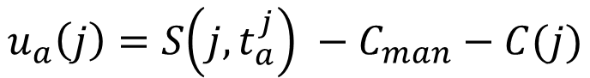
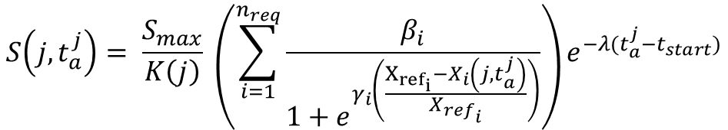
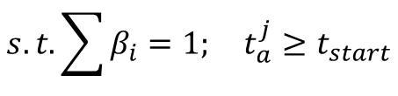
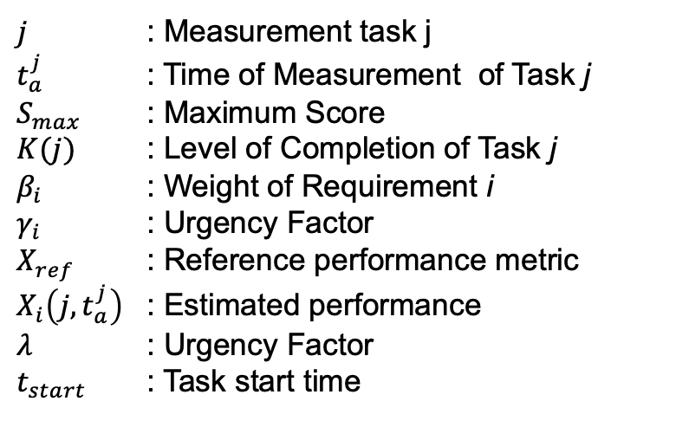
Requirement-Driven Utility Function
$$u_{a}\left(j\right)=S\left(j,t_{a}^{j}\right) −C_{man}−C(j)$$
$$S\left(j, t_{a}^{j}\right)= \frac{S_{max}}{K\left(j\right)} \left(\sum_{i=1}^{n_{req}}{\frac{β_{i}}{1+e^{γ_{i}\left(\frac{X_{{ref}_{i}}−X_{i}\left(j,t_{a}^{j}\right)}{{X_{ref}}_{i}}\right)}}}\right)e^{−λ(t_{a}^{j}−t_{start})}$$
$$s.t.\sum{β_{i}}=1; t_{a}^{j}≥t_{start}$$
Desired Dependencies
Temporal Constraints
Cross-registration with other satellites
Urgency
e.g., short-lived phenomena
Stakeholder Requirement Satisfaction
Spatial Resolution, Measurement Accuracy, etc…
Maneuvering Costs
Measurement Intrinsic Costs
$j$ : Measurement task j
$t_{a}^{j}$ : Time of Measurement of Task j
$S_{max}$ : Maximum Score
$K(j)$ : Level of Completion of Task j
$β_{i}$ : Weight of Requirement i
$γ_{i}$ : Urgency Factor
$X_{ref}$ : Reference performance metric
$X_{i}\left(j,t_{a}^{j}\right)$ : Estimated performance
$λ$ : Urgency Factor
$t_{start}$ : Task start time

Slide 56
Simulation Framework
Agent
Simulation Maintenance Module
Event Handler
-Simulation Events
Sim Start/End
-Environment Events
-Simulation Events
SUB
Environment
Engineering Module
REQ
Network Sim
-GP access req
-Agent access req
-Agent position req
-Agent eclipse req
-GP measurement observation metrics req
send_transmission():
---------------------------------------------------------------
Receive Transmission Request
Await self buffer allocation
Create Routing Plan
Await Access Start
Establish link
Await receiver’s buffer allocation
Start transmission
Await transmission completion
Simulate remaining time Delay
Delete message from buffer
-Measurement Request
-Information Request
-Measurement Results
-Planner Results
REP
Other Agents
receive_transmission():
---------------------------------------------------------------
Await reception request
Await to allocate transmission in buffer
Send allocation confirmation
Await transmission completion
Simulate remaining time delay
Delete message from buffer
Send transmission message to destined module for processing
REQ
-Measurement Request
-Information Request
-Measurement Results
-Planner Results

Slide 57
Simulation Framework
Agent
Simulation Maintenance Module
Event Handler
-Simulation Events
Sim Start/End
-Environment Events
-Simulation Events
SUB
Environment
Engineering Module
REQ
Platform Sim
-GP access req
-Agent access req
-Agent position req
-Agent eclipse req
-GP measurement observation metrics req
periodic_update():
---------------------------------------------------------------
Wait 1 time-step
Update state
Repeat forever
update_state():
---------------------------------------------------------------
dt = current time – previous update time
Update power and data for dt
Check if in eclipse
Check for pos and vel
Update component status
Trigger updated event
Internal_message_handler():
---------------------------------------------------------------
Await message
If message not meant for this module, forward to destination
If environment event, update state
If maintenance action, perform measurement
If measurement action,
If buffer allocation action,
If state request, send latest state
If critical state flag, request actions to operations planner. If no response and still critical, set platform state to false, else do actions and exit process
-Measurement Request
-Information Request
-Measurement Results
-Planner Results
critical_state_timer():
---------------------------------------------------------------
Get current state
If critical, send critical state flag and return
Predict next critical state
Await next critical state or updated event
If updated event, repeat from 1
Else, send critical state flag
perform_measurement():
---------------------------------------------------------------
asd
REP
Other Agents
REQ
-Measurement Request
-Information Request
-Measurement Results
-Planner Results
run():
---------------------------------------------------------------
Wait for all to end: internal_message_handler(), critical_state_timer()

Slide 58
ToDo’s
Engineering Model Integration
Alan: Power and Data Tracking Model
Ben: Attitude Model
Science Value Module
Ben: Spatial Res + Look Angle-based Chlorophyll + TSS
Federated Systems
Define federation in simpy
Use Case
Define federation in simpy

Slide 59
Types of Requests
Past Information Request
“I want soil moisture at (X,Y), does anyone know about this?”
“I am measuring SM at (X,Y) in 5 mins but need temperature measurements, does anyone know about this recently?”
“I an optical measurement from (X,Y), can you tell me if there is Algae here?”
New/Future Measurement Request
“Can someone measure SM at (X,Y) and tell me what the value is?”
Force Measurement Request
“You are measuring SM at (X,Y) because we told you to.”
Publish and subscribe protocol?
Sat X performs periodic measurements and list of Sats X_i receive the periodical data
Request protocol?
Only request the information you need

Slide 60
End Users
Initial Focus: Data collection of the network
Later Focus: Data downlink and information quality
Use case-specific metrics
i.e., How many times were algae blooms detected in single sat mission vs distributed mission
Evaluated information is obtained from GS performing information requests

Slide 61
Validation
Value of context-awareness
Fixed plan vs reactive plan
Importance of different information
No state info, no information requests

